Slide 1



Dr. Hiba Shakir Ahmed
Microbiology / Clinical Immunology

Slide 2
ORTHOMYXOVIRUSES (INFLUENZA VIRUSES)
Lecture 6

Slide 3
ORTHOMYXOVIRUSES (INFLUENZA VIRUSES)
Are major determinant of morbidity and mortality caused by respiratory disease and outbreaks of infection sometimes occurs in worldwide epidemics .
three immunological types of Influenza viruses are known designated A , B , (contains human and animal) and C (contains human and swine).
Influenza virus particles are usually spherical and about 100 nm in diameter it has negative sense single strand RNA (A and B with 8 separated segments while C has 7 segment of RNA).

Slide 4
Influenza virus particle contain 9 different structural proteins it has a lipid envelope derived from the cell surrounds the virus particle.
2 virus-encoded glycoproteins, the hemagglutinin (HA) and neuraminidase (NA) are inserted into the envelope
these 2 surface glycoproteins are the important antigens that determine antigenic variation of influenza viruses & host immunity .
there are 15 subtype of HA (H1-H15), and 9 subtype of NA (N1-N9) e.g., H1N1 Swine and H1N5 human.

Slide 5
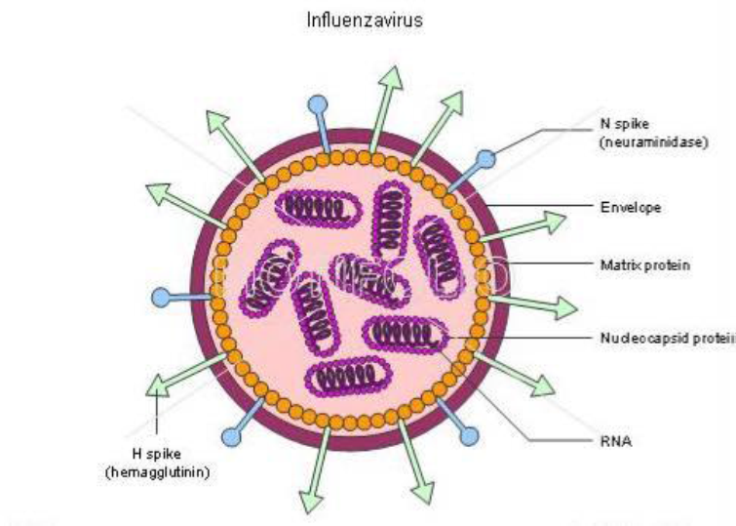
(INFLUENZA VIRUSES)

Slide 6
Clinical Finding
Influenza attacks mainly the upper respiratory tract it poses a serious risk for the elderly , the very young , and people with underlying medical conditions such as lung , kidney , or heart problems , diabetes and cancer.
Lab. Diagnosis
A- Isolation and identification of virus :
Nasal washings , gargles , and throat swabs are the best specimens for viral isolation and should be obtained within 3 days after the onset of symptoms. Classically embryonated eggs and primary monkey kidney cells have been the isolation methods of choice for influenza viruses.

Slide 7
B- Serology :
Antibodies to several viral proteins (HA , NA) are produced during infection with Influenza virus .
the immune response against the HA glycoprotein is associated with resistance to infection.
Routine sero-diagnostic test in use are based on hemagglutination inhibition (HI) and ELISA (Enzyme Linked ImmunoSorbent Assay). Neutralization test are the most specific and the best predictor of susceptibility to infection but are more unwieldy and more time-consuming to perform than other tests. ELISA test is more sensitive than other assays.

Slide 8


